Slide 1
Team 6: Micro:bit App
Developers
Ryan Philipps
Sam Stevenson
Tyler Marenger
Jared Schrauben
Wiley Roemer
Brandon Searle
Technical Writers
Sarah Linbeck
Lian Andersen
Scott Siviland
Ted Nachazel

Slide 2
System and Users
The Micro:bit application is a graphing application that uses a USB device known as a Micro:bit in order to collect data. The application supports several Micro:bit devices at once and displays the collected data on independent graphs which allow for data manipulation and saving (via downloading a CSV file).
The intended audience for this application is educators and students in middle school and high school for educational purposes.

Slide 3
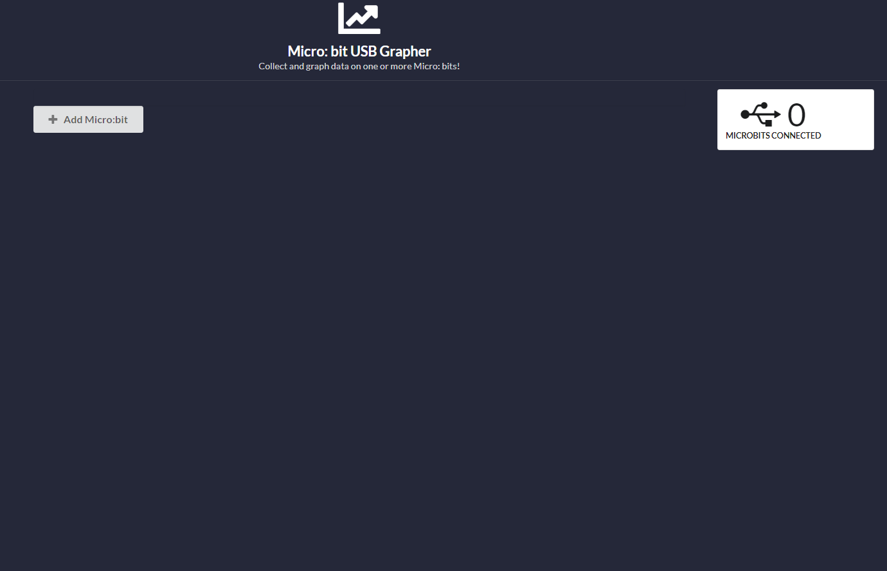
Application Demo
When a user accesses the webpage they will be presented with this screen
From here to user will connect and add their micro:bit using the Add Micro:bit button >
Connecting a micro:bit will increment the counter
This “sticks” to the page as the user scrolls

Slide 4
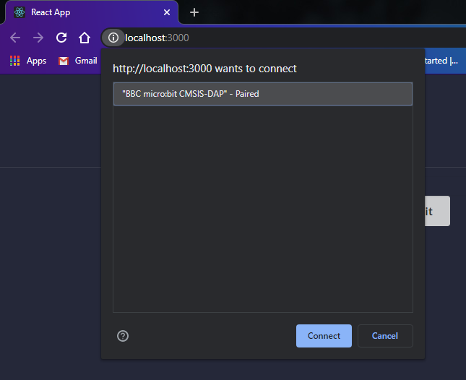
Application Demo
Upon pressing the `Add Micro:bit` button, Chrome WebUSB will display Micro:bits available to connect as shown here >
From here the user will select their Micro:bit(s) and then click connect

Slide 5
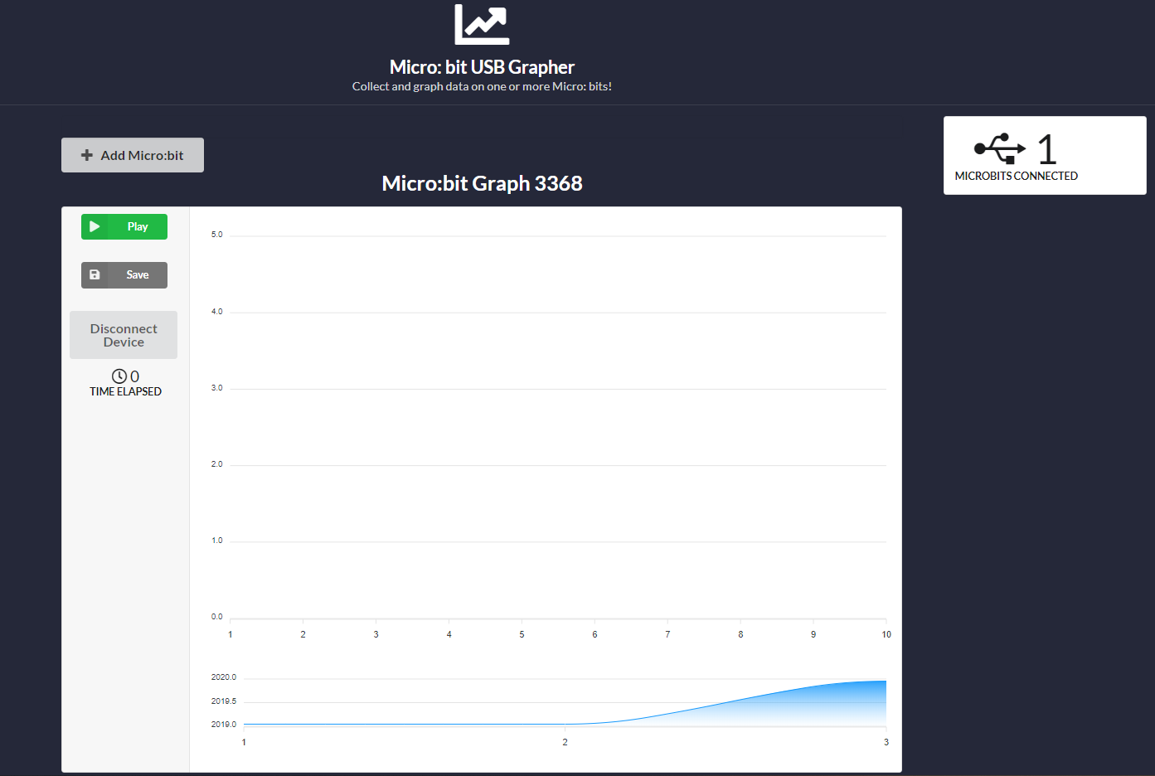
Application Demo
For each Micro:bit connected, a unique graph will be generated
Press `Play` to start graphing realtime data
Press `Save` to download data as a CSV
Press `Disconnect` to disconnect a Micro:bit from WebUSB
Time elapsed while graphing is displayed

Slide 6
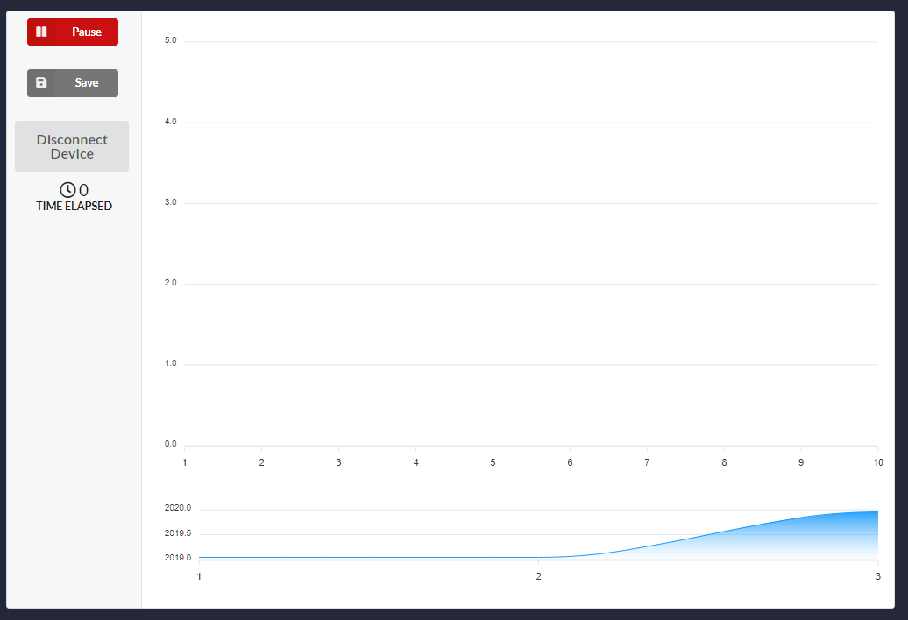
Application Demo
After clicking play, the button will toggle to a `Pause` button
The user can then press `Pause` to stop graphing data which can later be resumed

Slide 7
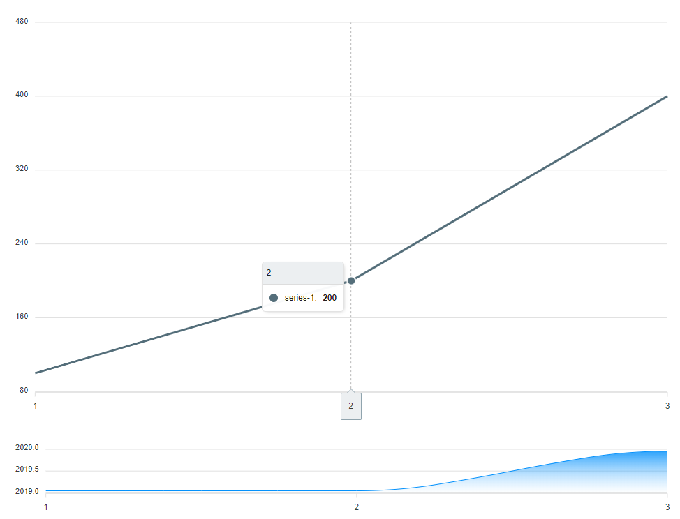
Application Demo
Our graphs support point-of-interest hovering
While hovering over the plot, the x-axis and y-axis values will be displayed
Supports Zooming and Panning through the graph
Zooming is done by using the bottom portion of the graph or using the scroll wheel
Panning is accomplishing by using the bottom portion of the graph or dragging the cursor on the graph

Slide 8
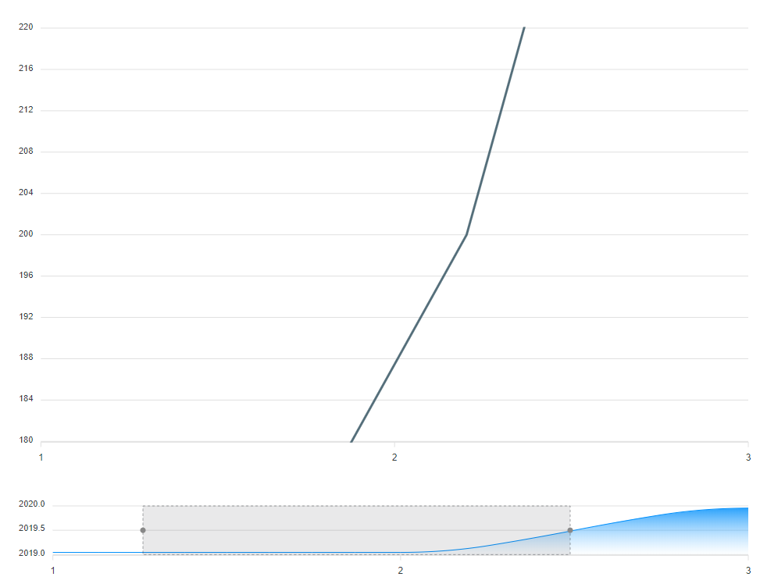
Application Demo
The bottom displays a chart which allows the user to view different ranges of data effectively
Drag left or right
Adjust size of range of data being displayed

Slide 9
Changes and Suggestions
Our team is exploring options to change our graph naming convention
The only unique identifier on the Micro:bits is the serial number, but we do not want to use this for each graph (due to the length)
We are considering just incrementing the graphs from 1 (ie. Graph 1, Graph 2, …)
The issue with this is it does not help the user identify which Micro:bit accompanies which graph
Our team is also looking at ways to improve the visual aspect of the buttons and their positioning

Slide 10
Instructional Information
Find the instructional document here: https://docs.google.com/document/d/1D3grMY1al05_76GEMyGy_MhFvsXQreGuWiZkM8oNhkE/edit?usp=sharing
Included in the instructional document is both text instruction and screenshots with diagrams.
This will be given to the test subjects so that improvements can be implemented afterwards.

Slide 11
Usability Concerns
There can be a concern with the obtaining the actual microbit for using the application.
This has been made evident from the current situation that we find ourselves in and the lack of available material.
There is also the issue of the purley unending scope of the application.
With the wide array of possible data inputs, there could be a chance to confuse the users.
Finally, there could be an issue that you can only download the graph as a CSV, as people might need a PDF or a JPEG.

Slide 12
Moving forward
Finished:
Connecting Micro:bits via WebUSB
Supports multiple Micro:bits
When a Micro:bit is paired, it constructs a unique graph
Save button downloads a CSV of data
Graphs are prepared to receive data
Panning, Zooming, and Hovering functionality
Plan to Finish:
Parse data from Micro:bit and feed to the graphs
Allow the user to edit the name of the graph (if they desire to)
Change graph naming convention
Format CSV data
Stretch Goals:
Construct a UI which allows the user to “combine graphs”
This will allow a plot to have multiple series lines

